Slide 1

THE
KOREAN
ALPHABET
Notes:
Hello, and welcome to this course that is going to teach you all there is to know about the Korean alphabet.

Slide 2
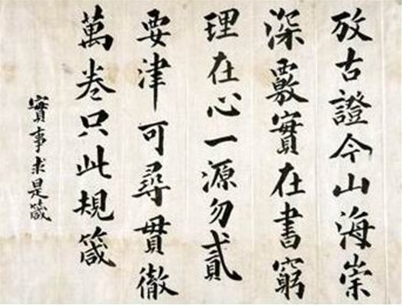

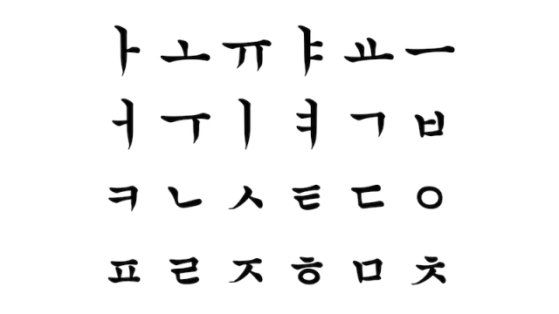
A BRIEF HISTORY
Sejong the great
108 BCE
1443 CE
Hanja
Hangeul
Notes:
First, let’s take a look at the history of the Korean alphabet. [click]. For many centuries, Koreans used the traditional Chinese characters to write Korean. Those traditional Chinese characters are known as hanja in Korean. They are very difficult to learn to write and. read as they are ideograms. An ideogram is one character that represents a whole word or concept. It takes thousands and thousands of ideograms to cover the whole language. On top of that, many ideograms are difficult to memorize due the number of strokes! [click] In 1443, so about six centuries ago, the majority of Koreans outside of the educated class could not read or write those hanjas and were thus illiterate. The King of Korea at the time, King Sejong the great, wanted to change that. He created a much simpler writing system that could be learned by all of his people in very little time. This writing system is the Korean alphabet that is still used today and that you will be learning in this course. This alphabet is known as Hangeul, and just like for the alphabet we use in English one character represents one sound, not a whole word! Okay, time to start learning the Hangeul. [click]

Slide 3
OBJECTIVE
01
To be able to recognize Hangeul
Notes:
There are three objectives in this course. The first one is to be able to recognize Hangeul among other writing systems. [click]

Slide 4
OBJECTIVE
02
To be able to read individual Hangeul letters
Notes:
The second objective is to be able to read individual letters from the Hangeul. [click]

Slide 5
OBJECTIVE
03
To be able to read words written in Hangeul
Notes:
Finally, by the end of the course you should be able to read entire words and sentences written in Hangeul! We will start by learning the Korean vowels in the next video. [click] [end of video 1]

